Slide 1
Sanajaya p csd-b title:how ai uses human

Slide 2
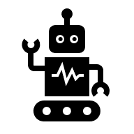
How does AI use Humans

Slide 3
Data Harvesting and Surveillance Capitalism
How ? : Al systems are taught using huge collection of information, most of which come from people - often without telling them clearly.
Is it real? : Facebook,Google,Amazon,Instagram
And others collect a huge amount of information about what people do online , such as what they watch ,like , or search for
Why it's dark? : peoples private actions and feelings are used without their permissions and here this process is hidden.

Slide 4
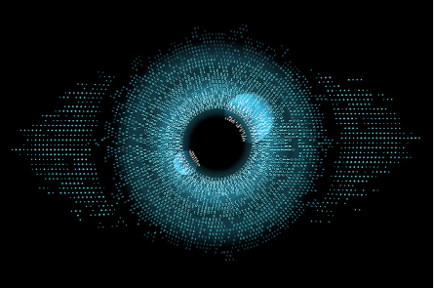
Manipulation through Algorithms
How?: Al predicts and shapes user behaviour via algorithms that keep them engaged for longer, often by showing things that make you feel strong emotion
Is it real?: You Tube:shows more and more videos to make people keep watching
Tik Tok/Instagram:while seeing so post or shorts that make people compare themself ,especially young users(endless scrolling without realizing it)
Why it's dark: Our attention becomes fuel that power the AI system

Slide 5
Deepfakes and Loss of Truth
How?: Al-generated fake videos, voices, or images that looks real and these are used to manipulate public perception
Is it real?: fake videos have been used in politics and in online scams
Why it's dark: It destroy trust,cofuses people about what’s real

Slide 6
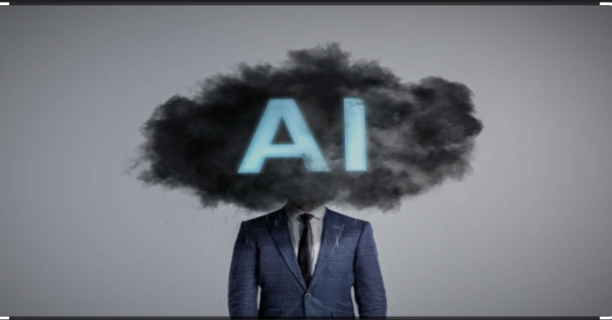
Ethical thoughts
(issues raised by use of AI)
1. Erosion of Autonomy (They decide for you)
Algorithms now plays a big part in ourlives, invisible ways:
What we see.
Who we meet.
What we buy.
2. Surveillance as a New Form of Power (Eyes are always watching)
Al creates a digital panopticon(CCTV,onlinetracking):
Always watching.
Always predicting.

Slide 7
The conclusion
While we often think we are using Al, the darker truth is that Al systems and the corporations behind them are using us:
“Our data fuels their growth,our behaviour trains their system,our attention feeds their profit”
Unless governed by strong ethical principles, public oversight, and human-centered design, Al will continue to use humanity to serve non-human goals - economic, algorithmic, or otherwise.

Slide 8
thank you

